Slide 1
Lecture Two: Database System Architecture
What you will learn from this lecture:
1. The Three Levels of the Architecture
三级模式结构
2. The Database Administrator
3. DBMS
4. Client/Server Architecture
5. Distributed Processing
ANSI/SPARC Architecture
From the point of view of development and execution of database applications

Slide 2
1.The Three Levels of the Architecture (ANSI/SPARC体系结构)
ANSI(American National Standards Institute)
美国国家标准协会
SPARC(Standards Planning and Requirements Committee)
美国国家标准协会的计算机与信息处理委员会中的标准规划与需求委员会
The Three Levels of the Architecture
三级模式结构
one
one

Slide 3
1.The Three Levels of the Architecture (ANSI/SPARC体系结构)
Conceptual Level (概念层)
External Level (外部层)-> 用户模式
Internal Level (内部层) -> 存储模式，物理存储
How the three levels of the architecture are typically realized in a relational system?
Conceptual/Internal Mapping (概念模式/内模式映射)
External/Conceptual Mapping(外模式/概念模式映射)
Data Independence (数据独立性)
one
one

Slide 4
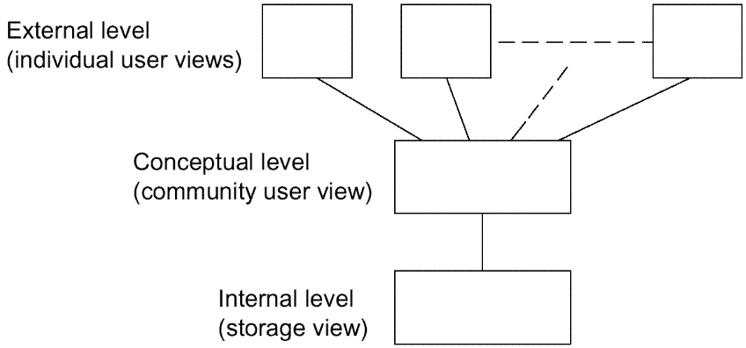
1.The Three Levels of the Architecture (ANSI/SPARC体系结构)
USER1(application programmer) USER2(end user) …
User logical level
concerned with the way the data is seen by individual users.
Community logical level
a representation of the entire information content of the database
Physical level
concerned with the way the data is physically stored.

Slide 5
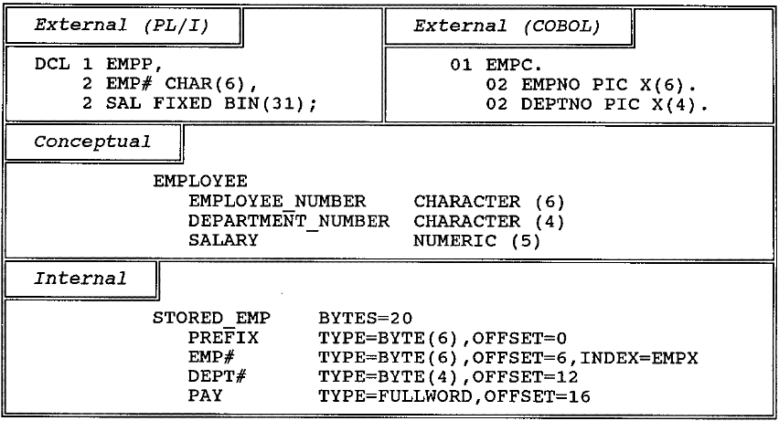
Fig. 2.2 An example of the three levels
CREATE VIEW EMPC(EMPNO,DEPTNO)
AS SELECT EMPLOYEE_NUMBER, DEPARTMENT_NUMBER
FROM EMPLOYEE;
GRANT SELECT ON EMPC TO USER02;

Slide 6
1.1 Conceptual Level
The conceptual view (概念视图)is a representation of the entire information content of the database.
The conceptual view is defined by means of the conceptual schema(概念模式).
我们以关系数据库为例，模式描述的是关系数据库中的所有关系（二维表）的结构，而对关系的描述就是关系模式，因此，关系数据库的模式就是指数据库中全体关系模式的集合。
例如：高校教务管理数据库：学生表、班级表、专业表、系表、课程表……

Slide 7
1.1 Conceptual Level
The conceptual schema is written using the conceptual DDL.
模式和数据
模式：对数据的描述和定义
数据：数据本身
模式的分类
源模式（DBA负责写）：没有运行的SQL语句
目标模式（保存在数据字典中）：运行好的，在数据库能查到的

Slide 8
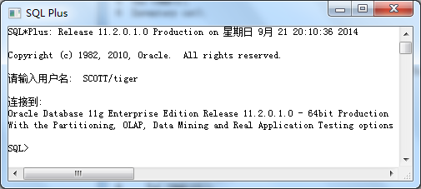
案例1：订单数据库的概念模式定义
以“SCOTT/tiger”身份登录ORACLE的SQL PLUS，创建订单数据库，定义概念模式。

Slide 9
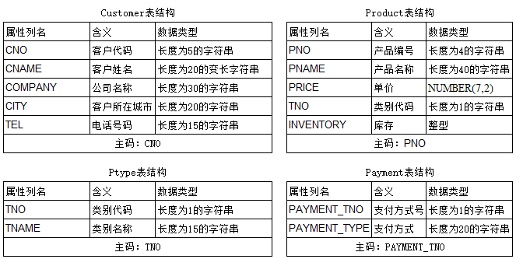
订单数据库表结构

Slide 10
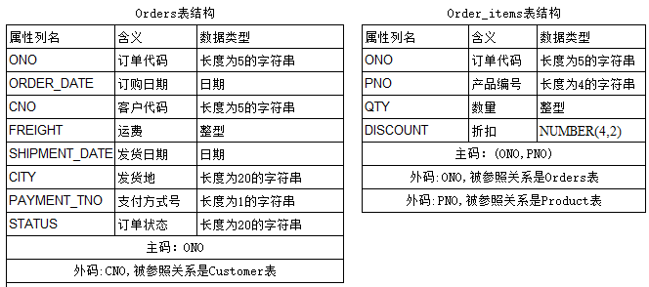
订单数据库表结构

Slide 11
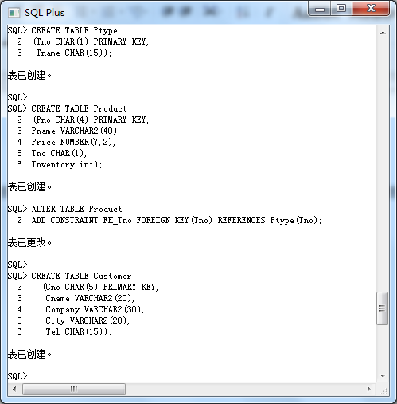
CREATE TABLE

Slide 12
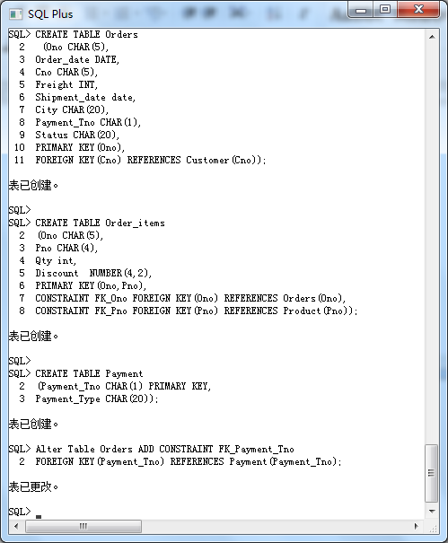
CREATE TABLE

Slide 14
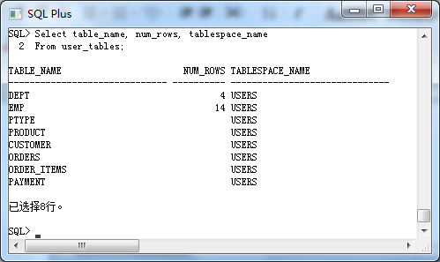
查看数据字典
源模式会转换成目标模式保存在数据字典中

Slide 15
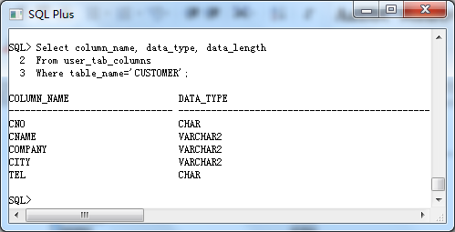

Slide 16
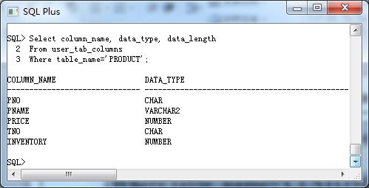

Slide 17
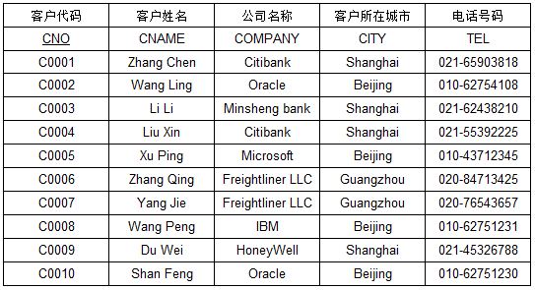
插入数据
INSERT INTO Ptype VALUES('1','Book');
INSERT INTO Product VALUES('1001','Advanced Marketing',20.50,'1',120);
INSERT INTO CUSTOMER
VALUES('C0001','Zhang Chen','Citibank','Shanghai','021-65903818');
…
INSERT INTO Orders
VALUES('O0001',' 10-3月-2014','C0001',8,' 11-3月-2014','Beijing','1','Complete');
INSERT INTO Order_items VALUES('O0001','1002',1,0.2);
(仅包含部分代码）

Slide 18
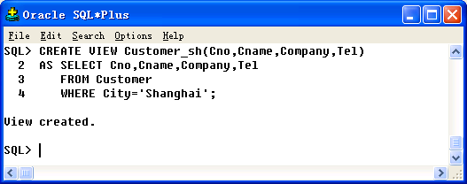
1.2 The External Level
External view is the individual user view.
GRANT SELECT ON Customer_sh TO USER01;

Slide 19
1.2 The External Level
DBA
GRANT SELECT ON Customer_sh TO USER01;
GRANT SELECT ON Product TO PUBLIC;
Product表
Customer_sh
导出
USER01外部视图
Customer表
Order表
SELECT * FROM Customer_sh;
SELECT * FROM Product;
Order_items表
External view is defined by means of an external schema (外模式). It is written using the external DDL.
Page

Slide 20
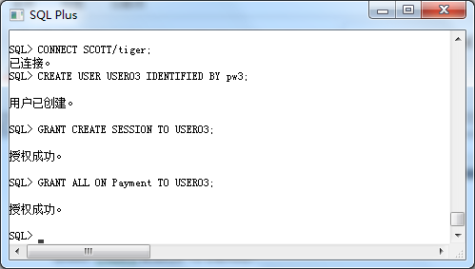
案例2：订单数据库的外模式定义
(1) 创建用户：USER03

Slide 21
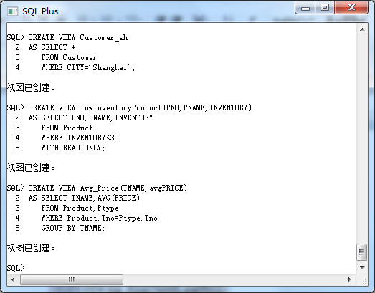
(2) 创建视图（数据库中的对象，本身不存放数据）

Slide 22
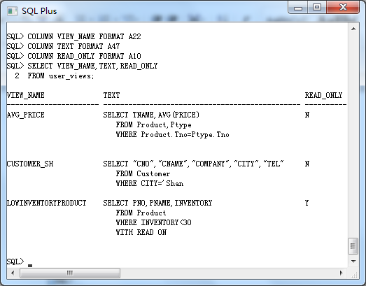
(3) 查看视图定义

Slide 23
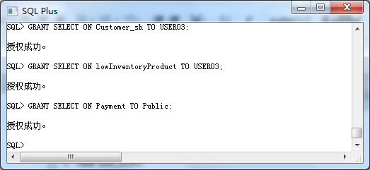
(4) 给USER03用户授权

Slide 24
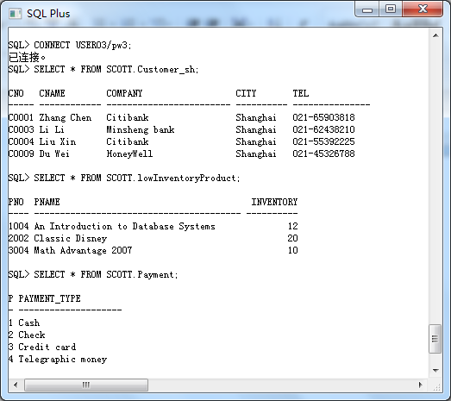
(5) 理解外部视图的概念

Slide 25
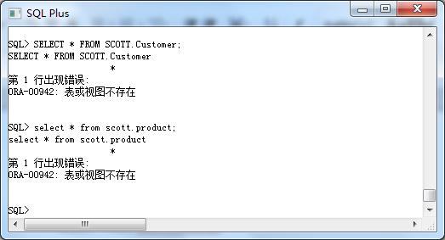
(5) 理解外部视图的概念…

Slide 26
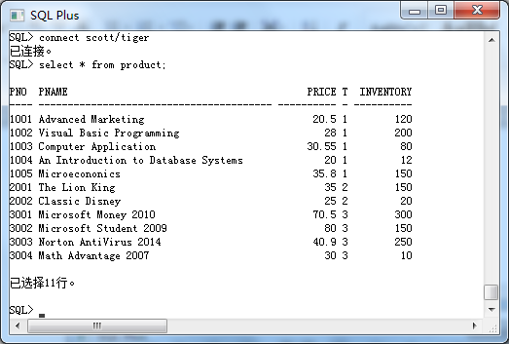
(5)理解外部视图的概念…

Slide 27
思考：
数据库的概念视图包含哪些对象？
USER03用户的外部视图包含哪些对象？
SCOTT用户的外部视图包含哪些对象？

Slide 28
1.2 The External Level…
User and language
Application programmer:
programming language, e.g., PL/I, C++, Java
Other users:
query language
application program
All such languages include a data sublanguage,it include DDL and DML.

Slide 29
1.2 The External Level…
Data sublanguage (DSL): is embedded within the corresponding host language.
Data Definition Language (DDL):supports the definition or declaration of database objects.
Data Manipulation Language (DML): supports the manipulation or processing of database objects.
Data sublanguage: responsible for database operations
Host language: responsible for nondatabase facilities
e.g., user interface, data input and output,
computational operations

Slide 30
1.3 The Internal Level
The internal view (storage view) is a low-level representation of the entire database.
The internal view is described by means of the internal schema (内模式).
The internal schema is written using the internal DDL.

Slide 31
1.4 How the three levels of the architecture are typically realized in a relational system?
The conceptual level in such a system will definitely be relational
Relational Tables
Relational Operators→ Result: Table
A given external view will typically be relational
Table or View
The internal level will not be relational
Stored records, Pointers (指针)
Indexes (索引) , hashes (散列), etc.

Slide 32
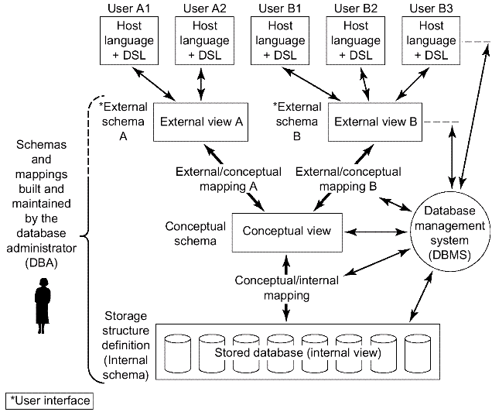
Fig. 2.3 Detailed system architecture

Slide 33
1.5 Conceptual/Internal Mapping
Defines the correspondence between the conceptual view and the stored database.
It specifies how conceptual records and fields are represented at the internal level.
It is the key to physical data independence :If the structure of the stored database is changed, the conceptual/internal mapping must be changed accordingly, so that the conceptual schema can remain invariant.

Slide 34
1.6 External/Conceptual Mapping
Defines the correspondence between a particular external view and the conceptual view.
Fields can have different data types; field and record names can be changed; several conceptual fields can be combined into a single (virtual) external field;
Any number of external views can exist at the same time;
Any number of users can share a given external view;
Different external views can overlap;
It is the key to logical data independence.

Slide 35
案例3:逻辑数据独立性
将Customer表拆成2个表
Customer1(Cno, CustomerName,Tel)
Customer2(Cno, CompanyName,City)
通过创建视图Customer，使得当概念模式改变之后，外模式可以保持不变。

Slide 36
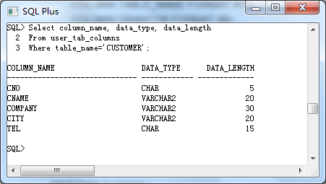

Slide 37
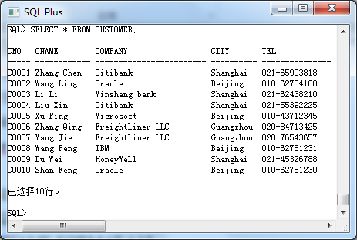

Slide 38
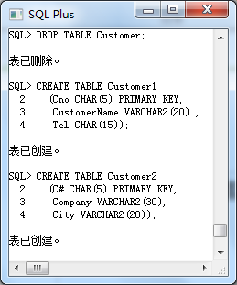
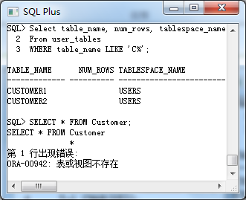
表中没有数据

Slide 39
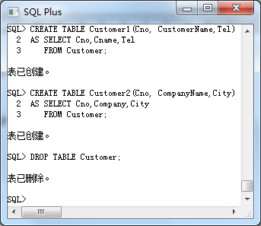
表中包含了原Customer表的数据

Slide 40
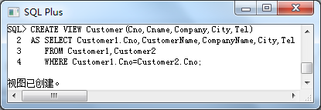
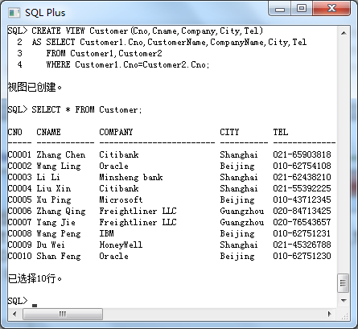

Slide 41
1.7 Data Independence
Data Independence: the ability to modify a schema definition in one level without affecting a schema definition in the next higher level
Logical data independence: the capacity to change the conceptual schema without having to change external schemas or application programs.
Physical data independence: the capacity to change the internal schema without having to change the conceptual (or external) schemas.
The mapping of three-schema architecture can make it easier to have true data independence.

Slide 42
1.7 Data Independence…
Physical Data Independence
Change the data physical representation and access technique without affecting the application.
Data physical representation : how the data is physically represented in storage
E.g.1, EMPLOYEE file: indexed on its "employee name" field
E.g.2, SALARY field of EMPLOYEE file: decimal or binary
Data access technique:
How the data is physically accessed

Slide 43
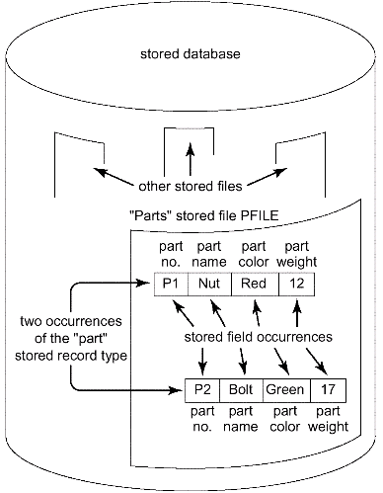
Stored fields, records, and files
Application
Logical field
Logical record
Column
Row
Table
Stored field: Type/instances
Stored record : Type/instances
Stored file
Fig. 1.7 Stored fields, records, and files

Slide 44
Structure of stored files
A given stored file can be physically implemented in storage in a wide variety of ways.
A single disk
Several different device
One or more indexes ,one or more embedded pointer chains (or both)
Some hashing scheme
DBA choose the stored representation of data.

Slide 45
2. The Database Administrator
DA(data administrator) is the person who makes the strategic and policy decisions regarding the data of the enterprise.
DBA is the person who provides the necessary technical support for implementing those decisions.
Defining the conceptual schema
Defining the internal schema
Defining the external schemas
Defining security and integrity constraints
Defining dump(数据转储) and reload policies
Monitoring performance and responding to changing requirements

Slide 46
Tasks of DBA
Defining the conceptual schema
(using conceptual DDL)
DA :decide the content of the database at an abstract level (Logical DB design)
DBA create the corresponding conceptual schema
SQL: create table
Defining the internal schema (using internal DDL)
The DBA must also decide how the data is to be represented in the stored database
(physical database design).

Slide 47
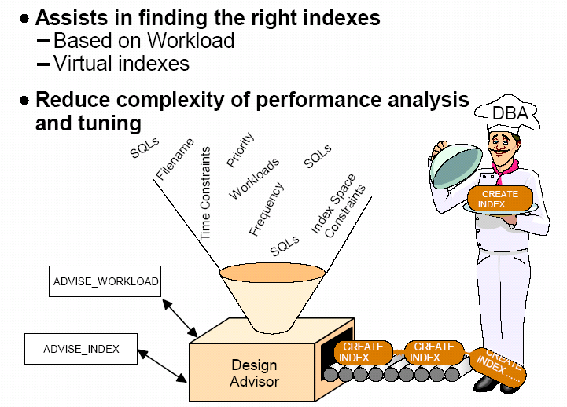
Tasks of DBA(Cont.)

Slide 48
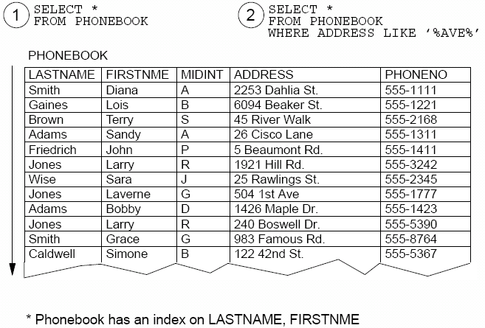
10. Database Administrator(Cont.)
Relation Scan
Page

Slide 49
Tasks of DBA
Defining the external schemas(using external DDL)
Liaising with users, ensure that the data they need is available.
Write the necessary external schemas and the corresponding external/conceptual mappings.
SQL: Create View, GRANT, REVOKE
Defining security and integrity constraints
Defining dump(数据转储) and reload policies
Monitoring performance and responding to changing requirements

Slide 50
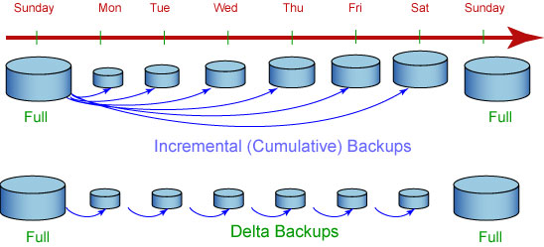
Tasks of DBA—数据转储(备份)
累积增量备份(Cumulative backup)：DB2 备份自上次完全数据库备份以来所更改的所有数据。
差异增量备份(Delta backup)：DB2 将只备份自上一次成功的完全、累积增量或差异增量备份以来所更改的数据。
如果星期五进行累积增量备份之后发生崩溃，那么可以先恢复第一个星期日的完全备份，然后恢复星期五进行的累积增量备份。
如果星期五进行 delta 备份之后发生崩溃，那么可以先恢复第一个星期日的完全备份，然后恢复从星期一到星期五（包括星期五）所进行的每次 delta 备份。

Slide 51
3. DBMS
Definition
How DB2 Handles an Request ?
Functions of DBMS
Major DBMS functions and components

Slide 52
3.1 Definition
Database management system (DBMS) is the software that handles all access to the database.

Slide 53
3.2 How DB2 Handles an Request ?
A user issues an access request, using some particular data sublanguage (typically SQL).
The DBMS intercepts that request and analyzes it.
The DBMS inspects the external schema for that user, the corresponding external /conceptual mapping, the conceptual schema, the conceptual/internal mapping, and the storage structure definition.
The DBMS executes the necessary operations on the stored database.

Slide 54
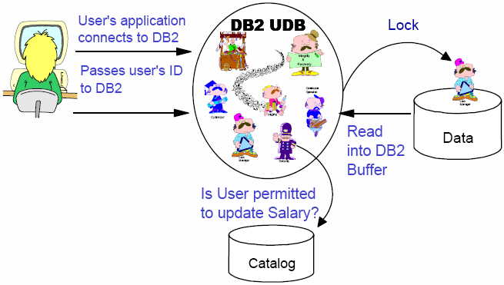
3.2 How DB2 Handles an Request ?...
How DB2 Handles an SQL “Change” Request ?
User wants to change a SALARY

Slide 55
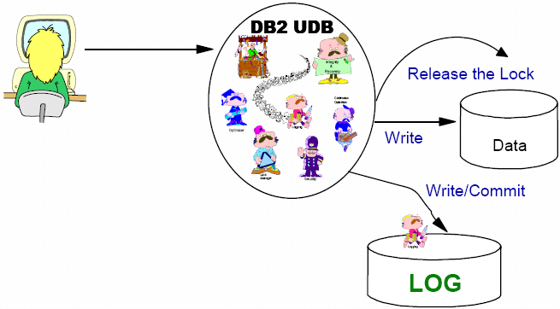
3.2 How DB2 Handles an Request ?...
Finish the change request
After the update

Slide 56
3.3 Functions of DBMS
Data definitions
Definition external schemas, the conceptual schema, the internal schema and all associated mappings.
Convert source form schema to the appropriate object form.
Include DDL processor or DDL compiler

Slide 57
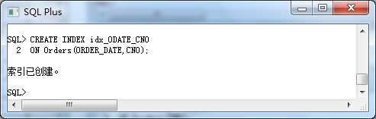
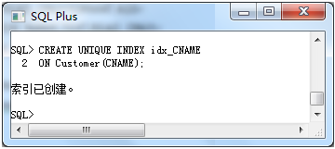
创建索引

Slide 58
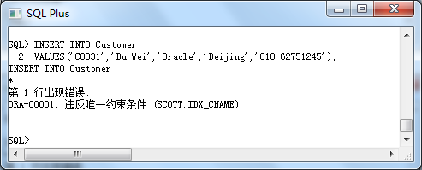
惟一性索引的作用
Customer表中原先就有一个姓名为“Du Wei”的客户！

Slide 59
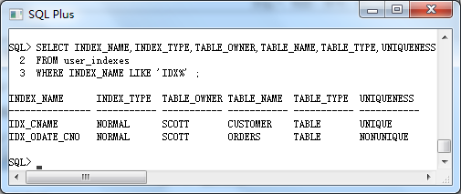
查看索引 user_indexes

Slide 60
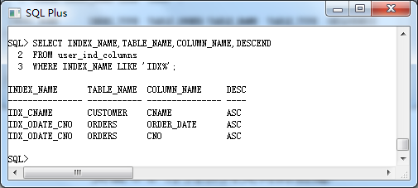
查看索引 user_ind_columns

Slide 61
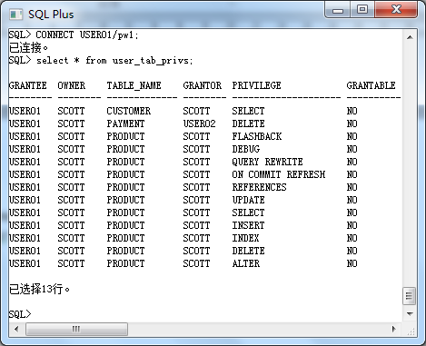
查看用户权限

Slide 62
3.3 Functions of DBMS…
Data manipulation:
retrieve, update, delete ,insert data to the database
Include DML processor or DML compiler
DML requests:
planned request
unplanned request: issued interactively via some query language processor.

Slide 63
3.3 Functions of DBMS…
Optimization and execution :
optimizer, run-time manager
Data security and integrity
Data recovery and concurrency:
transaction manager or transaction processing monitor
Data dictionary
Performance: efficiently

Slide 64
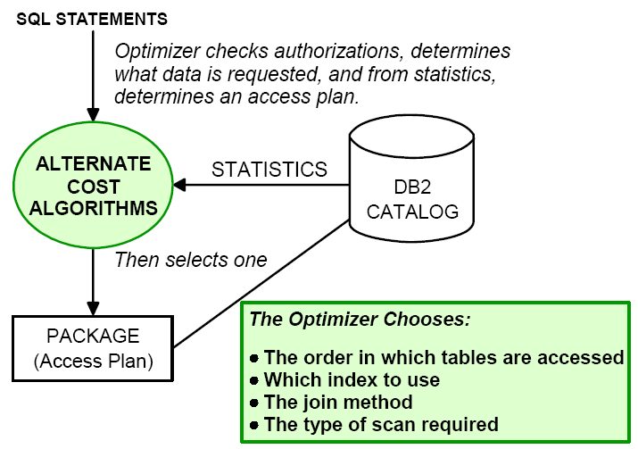
3.3 Functions of DBMS…
Optimization and execution

Slide 65
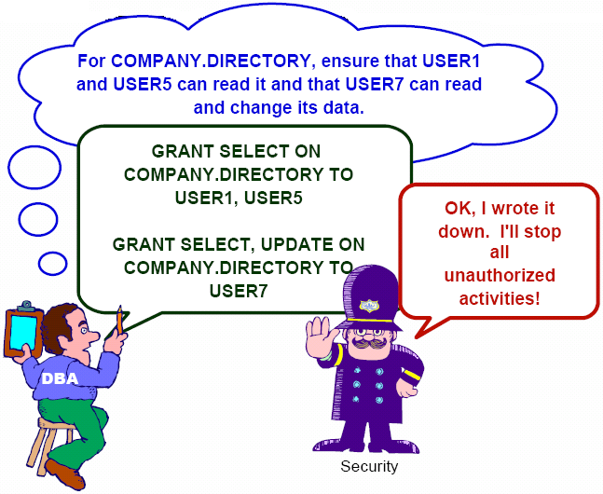
3.3 Functions of DBMS…
Security

Slide 66
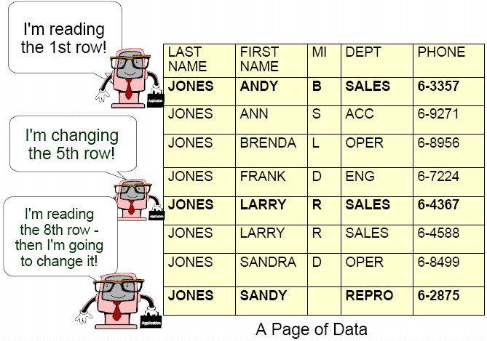
3.3 Functions of DBMS…
Concurrency—Down to the Row Level

Slide 67
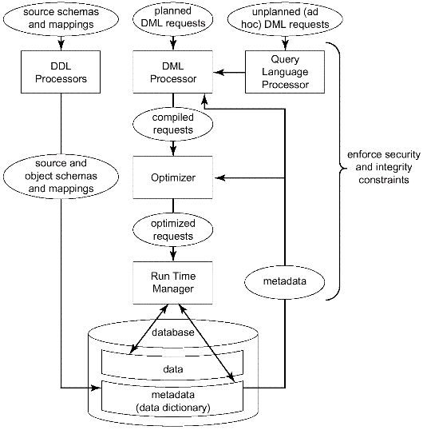
Fig. 2.4 Major DBMS functions and components
3.4 Major DBMS functions and components
Data definition
Data manipulation
Optimization and execution
Data security and integrity
Data recovery and concurrency
Data dictionary

Slide 68
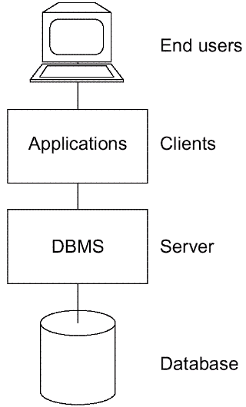
4. Client/Server Architecture
Server:
supports all of the basic DBMS functions.
Client:
clients are the various applications that run on top of the DBMS—both user-written applications and built-in applications, i.e., applications provided by the DBMS vendor or by some third party.
Fig. 2.5 Client/server architecture

Slide 69
4. Client/Server Architecture(Cont.)
User-written applications:
regular application programs
written in C ,COBOL ,Java,…
Vendor-provided applications(tools):
assist in the creation and execution of other applications
E.g., report writer:
allow user to obtain formatted reports through report writer language.

Slide 70
Vendor-provided tools
Query language processors
Report writers
Business graphics subsystems
Spreadsheets
Natural language processors
Statistical packages
Copy management or "data extract" tools
Other application development tools, including computer-aided software engineering (CASE) products;

Slide 71
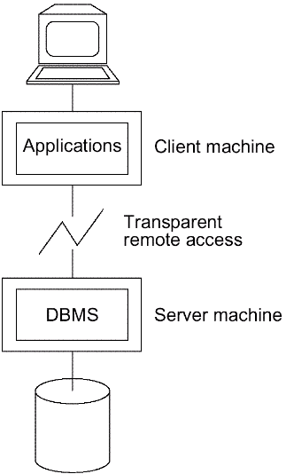
5. Distributed Processing
a single data-processing task can be spread across several machines in the network.
Fig. 2.6 Client (s) and server running on different machines

Slide 72
Client (s) and server running on different machines—Benefit
Server (database) and client (application) processing are being done in parallel. Response time and throughput should thus be improved.
The server machine might be a custom-built machine that is tailored to the DBMS function (a "database machine") and might thus provide better DBMS performance.
The client machine might be a personal workstation, tailored to the needs of the end user and thus able to provide better interfaces, faster responses, and overall improved ease of use to the user.
Several different client machines might be able (in fact, typically will be able) to access the same server machine.

Slide 73
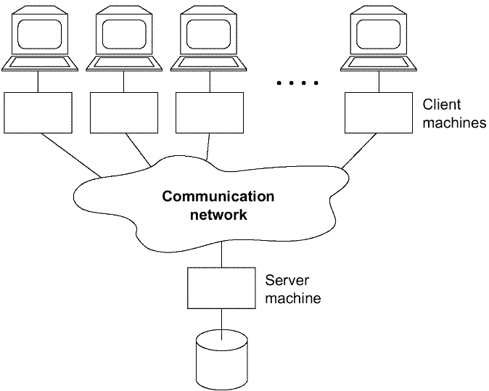
Fig. 2.7 one server machine, many client machines
One server machine, many client machines

Slide 74
Each machine runs both client (s) and server
A given client might be able to access any number of servers, but only one at a time (i.e., each individual database request must be directed to just one server). In such a system it is not possible, within a single request, to combine data from two or more different servers. Furthermore, the user in such a system has to know which particular machine holds which pieces of data.
The client might be able to access many servers simultaneously (i.e., a single database request might be able to combine data from several servers). In this case, the servers look to the client—from a logical point of view—as if they were really a single server, and the user does not have to know which machines hold which pieces of data. -- distributed database system.

Slide 75
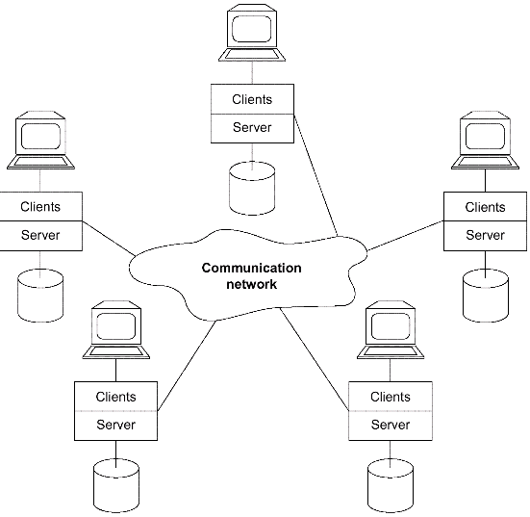
Each machine runs both client (s) and server
Fig. 2.8 Each machine runs both client (s) and server

Slide 76

Thank You!

